Slide 1
Formal letter and informal letter

Slide 2
Formal letter and informal letter
Definition of formal letter and informal letter.
Rules for writing formal letter.
Content of formal letter
The different from American style and British
Abbreviation used in letter writing.
The format of informal letter.
Sample of formal letter.
Sample of informal letter.

Slide 3
A. DEFINITION OF FORMAL LETTER AND INFORMAL LETTER
A formal letter is a letter written to a business, a college, or any professional that are not considered friends or family.
An informal letter is a letter you would write to a friend or family

Slide 4
B.RULES FOR WRITING FORMAL LETTER IN ENGLISH
Addresses:
1) Your Address The return address should be written in the top right-hand corner of the letter.
2) The Address of the person you are writing to The inside address should be written on the left, starting below your address.
Date:
Different people put the date on different sides of the page. You can write this on the right or the left on the line after the address you are writing to. Write the month as a word.

Slide 5
Salutation or greeting and ending a letter
Salutation
1) Dear Sir or Madam, If you do not know the name of the person you are writing to, use this. It is always advisable to try to find out a name.
2) Dear Mr Jenkins, If you know the name, use the title (Mr, Mrs, Miss or Ms, Dr, etc.) and the surname only. If you are writing to a woman and do not know if she uses Mrs or Miss, you can use Ms, which is for married and single women.
Ending a letter:
1) Yours faithfully If you do not know the name of the person, end the letter this way.
2) Yours sincerely If you know the name of the person, end the letter this way.
3) Your signature Sign your name, then print it underneath the signature. If you think the person you are writing to might not know whether you are male of female, put you title in brackets after your name.

Slide 6
C.CONTENT OF A FORMAL LETTER
Content of a Formal Letter
First paragraph The first paragraph should be short and state the purpose of the letter- to make an enquiry, complain, request something, etc.
The paragraph or paragraphs in the middle of the letter should contain the relevant information behind the writing of the letter. Most letters in English are not very long, so keep the information to the essentials and concentrate on organising it in a clear and logical manner rather than expanding too much.
Last Paragraph The last paragraph of a formal letter should state what action you expect the recipient to take- to refund, send you information, etc.

Slide 7
D.The style of formal letter in America and UK is different from some aspect.
ϖ American Style 1. Heading According to the format, but usually aligned to the left. 2. Date January 17, 2009(month-day-year). According to the format but usually aligned to the left (two lines below the heading). 3. Salutation Dear Mr. / Mrs. Ana: Dear Sir or Madam: Gentlemen: After the salutation there is a colon (:) 4. Complimentary close Sincerely, Sincerely yours, Yours truly,
ϖ British Style 1. Heading The heading is usually placed in the top right corner of the letter (sometimes centered). 2. Date 17 January 2009 (day-month-year) Usually placed directly (or one blank line) below the heading. 3. Salutation Dear Mr. / Mrs. Ana, Dear Sir or Madam, Gentlemen, After the salutation there is a comma (,) 4. Complimentary close Sincerely, Yours sincerely, Yours faithfully,

Slide 8
E.Abbreviations used in letter writing
Abbreviations Used in Letter Writing
The following abbreviations are widely used in letters:
asap = as soon as possible
cc = carbon copy (when you send a copy of a letter to more than one person, you use this abbreviation to let them know)
enc. = enclosure (when you include other papers with your letter)
pp = per procurationem (A Latin phrase meaning that you are signing the letter on somebody else's behalf; if they are not there to sign it themselves, etc)
ps = postscript (when you want to add something after you've finished and signed it)
pto (informal) = please turn over (to make sure that the other person knows the letter continues on the other side of the page)
RSVP = please reply

Slide 9
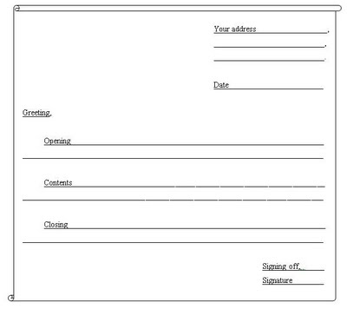
F. Informal letter The format:

Slide 10
The language used is simple and friendly
You can use contractions such as can’t, I’m, won’t, you’re and so on.
For examination, do not use slang like, “Hey, Wassup.” , “gonna” , “kinda”, “wanna”

Slide 11
The format of writing an informal letter
Format
Explanation
Address
· The writer’s address is written at the top right-hand corner
· For example:
25, Jalan Tebing 8/8,
Seksyen 8,
40000 Shah Alam,
Selangor Darul Ehsan.
Date
· Written below the address.
For example: 6 June 2011 For example: 6 June 2011

Slide 12
Greeting
· Written on the left-hand side of the letter.
Begin with:
Ø Dear........,
For example: Dear Amin, Dear Latifah,
Ø Dearest…….., or My dear…., (for close friends & family)
For example: Dearest father, My dear Uncle Syed, Dearest Siti,

Slide 13
Opening(1st paragraph)
You may begin your letter by:
· Asking about the person’s health. For example:
Ø How are you? I hope that you’re in the pink.
Ø How’s your family getting on?
Ø I’m fine and I hope you’re fine too.
Ø I hope that you’re as fit as a fiddle.
· Asking what the reader had been up to?
Ø How’s the weather at your place? Not too hot I hope.
Ø Did you get to visit your grandparents?
Ø Did you go on your trip to Paris as you had hoped? They say Paris is a beautiful city.
·

Slide 14
Expressing happiness and sorrow
· Expressing happiness: For example:
Ø I received your letter on…
Ø I’m happy to receive your letter…
Ø Thank you for your letter which I received…..
Ø I’m so glad to hear…..
Ø I’m glad to learn that….
· Expressing sorrow:
Ø I’m sorry to hear that…..
· Expressing apology:
Ø I’d like to say sorry for…
Ø I’m sorry for not writing….

Slide 15
Content(several paragraph)
· In the 2nd paragraph, mention your main reason for writing the letter. You may use the following phrase:
Ø In your last letter, you wanted me to describe / advice…..
Ø I’m writing this letter to….

Slide 16
Closing(last paragraph)
Inform the reader that you are ending the letter. You mayuse the following phrases:
Ø I’ll write again soon.
Ø Do write to me soon.
Ø Well, that’s about all for now.
Ø Please give/send my regards to…
Ø Please convey my warm regards to….
Ø Let me pen off here.
Ø Take care of yourself.
Ø Hope to hear from you soon.
Ø I’m looking forward to hearing from you soon.
Ø Hope to receive a reply from you.
Ø Bye / Goodbye.

Slide 17
Signing off
Signing off
If you are writing to your parents, you can sign ofusing:
Ø Your loving daughter,
Ø Yours lovingly,
Ø Yours affectionately
If you are writing to friends or relatives, you can sign off using:
Ø Your friend,
Ø Yours sincerely,
Ø Yours faithfully,
Ø Your niece / nephew,

Slide 18
Signature
Sign your name at the bottom of the letter in the right-hand corner.
For example:
Nuurunnuha

Slide 19
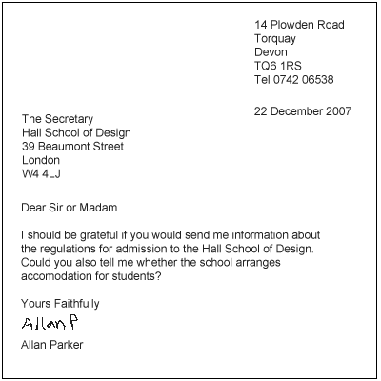
G.Sample of formal letter

Slide 20
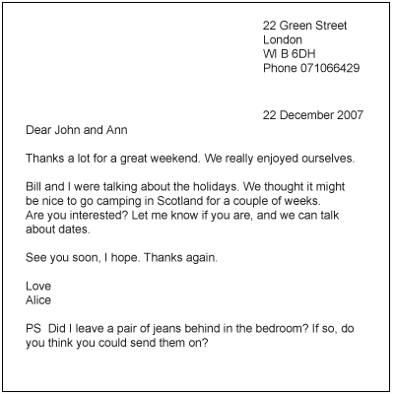
H.Sample of informal letter

